Slide 1

Song Analysis and Yielding Suggestions (SAYS)
Authors: Ajay Kumar Gupta, Srinivas Shavukapu, Sonu Goyal, Yuvaraj G
DA 231o Data Engineering at Scale (August 2025 Term)
Notes:
This project was developed as part of the DA 231o Data Engineering at Scale (August 2025 Term), during the M.Tech (Online) program at IISc by four professionals named as Ajay Kumar Gupta, Srinivas Shavukapu, Sonu Goyal, Yuvaraj G.

Slide 2
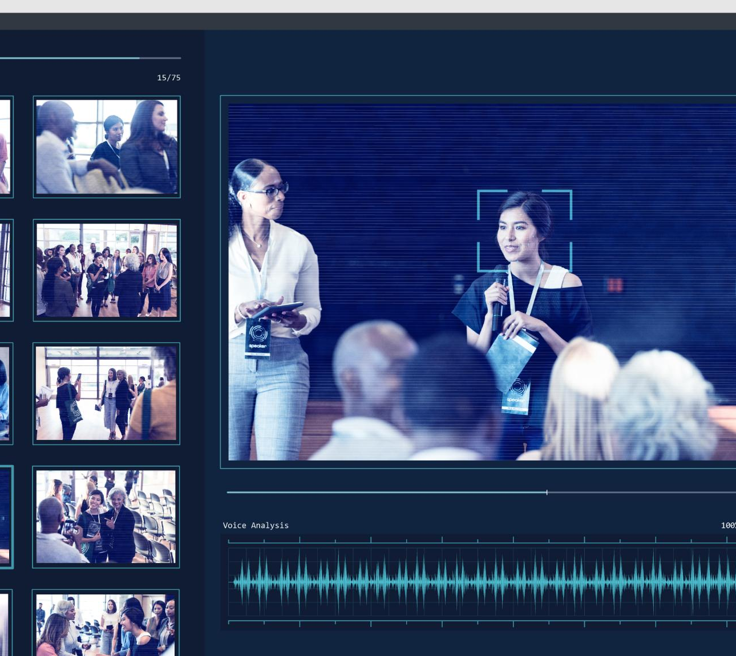
Project Overview
Project Objective
  Design and implement a scalable music recommendation system using user data and audio features for personalization.
Challenges Addressed
  Tackles the problem of content overload on music platforms by providing tailored user experiences.
Technologies Used
  Implements big data technologies and machine learning techniques for robust and scalable solutions.
Collaborative Effort
  Project developed collaboratively by four authors focusing on comprehensive system design and evaluation.
Notes:
The project titled 'Song Analysis and Yielding Suggestions (SAYS)' was developed as part of the DA 231o Data Engineering at Scale course during the August 2025 term. The primary objective of this project is to design and implement a scalable music recommendation system that leverages user interaction data and audio features to generate personalized recommendations. The system aims to address the challenges posed by the exponential growth of music streaming platforms, where users are often overwhelmed by vast content and demand highly personalized experiences. The authors of the project include Ajay Kumar Gupta, Srinivas Shavukapu Kattegummula, Sonu Goyal, and Yuvaraj G, who collaborated to create a robust solution using big data technologies and machine learning techniques. This presentation will provide a comprehensive overview of the problem statement, motivation, design goals, architecture, methods, evaluation metrics, key outcomes, challenges faced, and future extensions of the project.

Slide 3

Challenges and Need for Personalization
User Discovery Challenges
  Users struggle to find relevant music due to massive streaming libraries and limited recommendation scalability.
Limitations of Traditional Systems
  Conventional recommendation systems face issues with real-time performance and adapting to dynamic user behavior.
Big Data and Personalization
  Leveraging big data frameworks and machine learning enables efficient, low-latency personalized music recommendations.
Goal for Enhanced Experience
  Integrating real-time orchestration tools aims to improve user engagement through accurate, timely recommendations.
Notes:
The core problem addressed by the SAYS project is the difficulty users face in discovering relevant music content amidst the massive libraries offered by streaming platforms. Traditional recommendation systems often struggle with scalability, real-time performance, and adaptability to dynamic user behavior. As user expectations for personalized experiences continue to rise, there is a pressing need for systems that can process large-scale datasets efficiently and deliver recommendations with low latency. The motivation behind this project stems from the limitations of conventional approaches and the opportunity to leverage big data frameworks like Apache Spark to build a distributed, fault-tolerant pipeline. By integrating machine learning models and real-time orchestration tools, the project aims to enhance user engagement and satisfaction through accurate and timely recommendations.

Slide 4

Objectives and Requirements
Scalability
  The system supports millions of user-song interactions without performance degradation.
Performance
  Low-latency recommendations provide a smooth and seamless user experience.
Reliability
  Automated orchestration with retry mechanisms ensures graceful failure handling.
Flexibility
  Easy deployment and integration with user interfaces for adaptable system use.
Notes:
The design goals of the SAYS project are centered around four key aspects: scalability, performance, reliability, and flexibility. Scalability ensures that the system can handle millions of user-song interactions without degradation in performance. Performance focuses on delivering low-latency recommendations to maintain a seamless user experience. Reliability is achieved through automated orchestration with retry mechanisms to handle failures gracefully. Flexibility emphasizes ease of deployment and integration with user interfaces. To meet these goals, the system incorporates distributed data processing, ML-based collaborative filtering, an interactive UI for recommendations, and automated pipeline orchestration. These objectives collectively ensure that the system is robust, efficient, and adaptable to evolving user needs.

Slide 5

Dataset and Feature eNGINEERING
User-Song Interaction Data
  Dataset includes user IDs, track IDs, and ratings detailing user-song interactions for personalized recommendations.
Audio Feature Integration
  Audio features such as tempo, energy, and danceability enhance recommendation accuracy and context awareness.
Data Quality and Schema
  An explicit Spark schema enforces type safety and maintains high data quality within the data pipeline.
Model Training and Evaluation
  Dataset is split 80/20 into training and testing sets to ensure robust evaluation of recommendation accuracy.
Notes:
The dataset used in the SAYS project consists of user-song interaction records, including fields such as user_id, track_id, and rating. Additionally, audio features like tempo, energy, and danceability were incorporated to enrich the recommendation process. An explicit Spark schema was defined to ensure type safety and maintain data quality throughout the pipeline. The model training process involved splitting the dataset into an 80/20 train-test ratio, enabling robust evaluation of recommendation accuracy. By combining interaction data with audio features, the system delivers more personalized and context-aware recommendations.

Slide 6
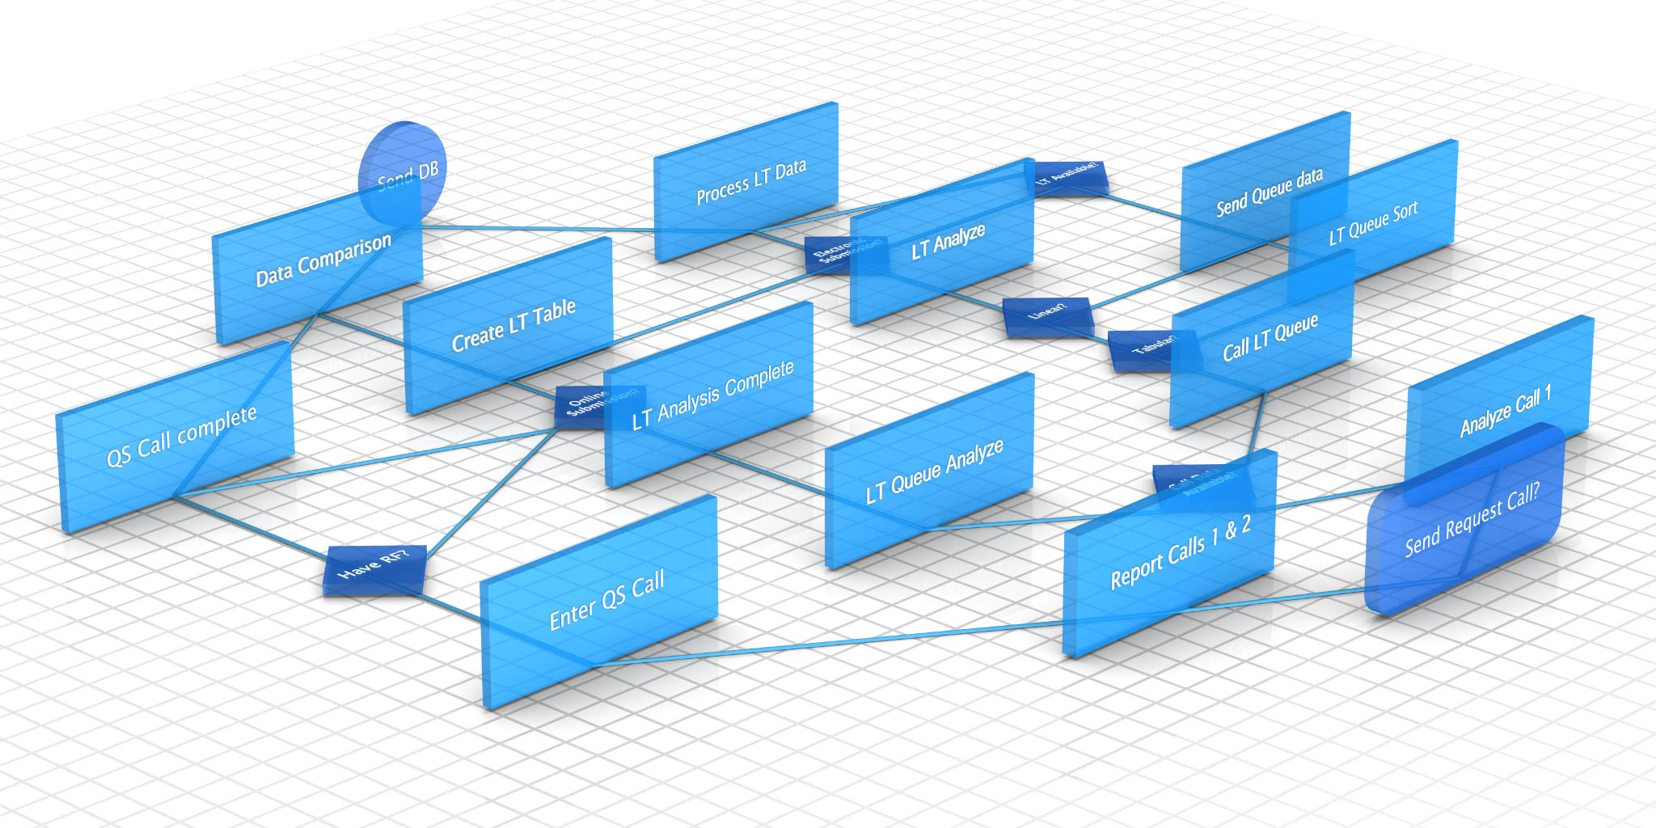
Pipeline and Algorithms
Distributed ETL Pipeline
  A distributed ETL pipeline processes raw user data, engineers features, and prepares data for model training effectively.
ALS Collaborative Filtering
  ALS algorithm is used for scalable recommendation with parameters Rank=20, Iterations=10, and Regularization=0.1.
Cold Start and Constraints
  Cold start issue addressed by drop strategy and non-negative constraints to improve recommendation quality.
Orchestration and UI
  Prefect orchestrates task automation and error handling; Streamlit UI provides responsive user recommendations.
Notes:
The approach adopted in the SAYS project involves building a distributed ETL pipeline that processes raw user interaction data, engineers relevant features, and trains a machine learning model for recommendations. The ALS collaborative filtering algorithm was chosen for its effectiveness in handling large-scale recommendation tasks. Key parameters for ALS include Rank set to 20, Iterations set to 10, and Regularization parameter set to 0.1. To address the cold start problem, a drop strategy was implemented, and non-negative constraints were applied. The pipeline is orchestrated using Prefect, which automates task execution and error handling. The final recommendations are served through a Streamlit-based UI, ensuring an intuitive and responsive user experience.

Slide 7

MODELS
Baseline Model
Popularity-based recommender: Recommend the most frequently played or highest-rated tracks globally (or per segment), independent of the user.
Why use it: Simple, fast, and sets a clear baseline to compare against model-based approaches.
Limitations: No personalization; ignores user taste and item similarity; weak performance for diverse catalogs.
Collaborative Filtering with ALS:
Learns latent factors for users and items from interaction data.
Predicts scores via dot product of user and item embeddings.
Handles sparse data and scales well with Spark
Notes:
The approach adopted in the SAYS project involves building a distributed ETL pipeline that processes raw user interaction data, engineers relevant features, and trains a machine learning model for recommendations. The ALS collaborative filtering algorithm was chosen for its effectiveness in handling large-scale recommendation tasks. Key parameters for ALS include Rank set to 20, Iterations set to 10, and Regularization parameter set to 0.1. To address the cold start problem, a drop strategy was implemented, and non-negative constraints were applied. The pipeline is orchestrated using Prefect, which automates task execution and error handling. The final recommendations are served through a Streamlit-based UI, ensuring an intuitive and responsive user experience.

Slide 8

Architecture and Components
Data Layer Optimization
  Handles raw CSV files and converts them into Parquet format for efficient storage and querying.
Processing with Apache Spark
  Uses Apache Spark for distributed data transformations and feature engineering to prepare data for modeling.
Collaborative Filtering Model
  Implements ALS algorithm to generate personalized recommendations based on user data.
Orchestration and Deployment
  Prefect manages task scheduling and reliability; Docker enables containerization for portability.
Notes:
The architecture of the SAYS system is designed as a distributed pipeline comprising multiple layers. The Data Layer handles raw CSV files and converts them into optimized Parquet format for efficient storage and querying. The Processing Layer utilizes Apache Spark for distributed transformations and feature engineering. The Model Layer implements ALS (Alternating Least Squares) collaborative filtering to generate personalized recommendations. Orchestration is managed by Prefect, which ensures task scheduling, retries, and logging for reliability. The UI Layer is built using Streamlit, providing an interactive interface for users to access recommendations in real time. Finally, deployment is facilitated through Docker, enabling containerization and portability across environments. This layered architecture ensures modularity, scalability, and fault tolerance.

Slide 9
Achievements and Impact
Goal | Achievement
Handle large datasets | Distributed Spark ETL with Parquet storage
Real-time recommendations | Streamlit UI with on-demand prediction
Fault tolerance | Prefect orchestration with retry logic
Efficient storage | Columnar Parquet format for optimized queries
Notes:
The SAYS project successfully met its design goals by delivering a scalable, distributed pipeline capable of processing large volumes of user interaction and audio feature data. Key achievements include horizontal scalability through Spark-based transformations, performance benchmarks with RMSE ≈ 0.85, and robust automation using Prefect for workflow management. The integration of a Streamlit UI provided real-time recommendations with configurable parameters, enhancing user experience. Deployment via Docker ensured portability and reproducibility across environments. These outcomes collectively demonstrate the effectiveness of the system in addressing the challenges of modern music recommendation platforms.

Slide 10

Metrics and Analysis
Error Metrics Overview
  The model's accuracy was evaluated using RMSE and MAE, achieving values of 0.85 and 0.65 respectively.
Experiment Design
  An 80/20 train-test data split was used to validate the model's performance and scalability.
Scalability Analysis
  Scalability was analyzed through Spark shuffle partitions and execution times for ETL and training phases.
Performance Visualizations
  Visual tools like RMSE vs iterations, rating histograms, and Top-K accuracy plots provided insights on model and user behavior.
Notes:
The evaluation of the SAYS system was conducted using standard metrics such as RMSE (Root Mean Square Error) and MAE (Mean Absolute Error). The model achieved an RMSE of approximately 0.85 and an MAE of around 0.65, indicating high accuracy in generating recommendations. The experiment design included an 80/20 train-test split and analysis of scalability metrics such as Spark shuffle partitions and execution time for ETL and training. Additional visualizations, including RMSE vs. iterations, rating distribution histograms, and Top-K recommendation accuracy plots, were generated to provide deeper insights into model performance and user behavior.

Slide 11

Challenges Addressed
Data Quality Assurance
  Data quality issues were resolved using schema validation and null value handling techniques.
Cold Start Problem Solution
  The cold start problem was addressed by configuring ALS with non-negative constraints and applying a drop strategy.
Pipeline Reliability
  Pipeline reliability was ensured through automated error handling and dependency management using Prefect.
Notes:
Several challenges were encountered during the development of the SAYS system. Data quality issues were mitigated through schema validation and null handling. The cold start problem was addressed by configuring ALS with non-negative constraints and implementing a drop strategy. Pipeline reliability was ensured through automated error handling and dependency management using Prefect. These measures collectively enhanced the robustness and accuracy of the system.

Slide 12

Future Extensions
Hybrid Recommendation Models
  Combining collaborative filtering with content-based and deep learning models enables more accurate recommendations.
Real-time Data Streaming
  Adding real-time streaming with Apache Kafka enables live data ingestion and timely updates.
Cloud Deployment
  Deploying on cloud platforms provides elastic scaling and managed infrastructure for SAYS system.
Enhanced User Interface
  Improved UI with visual analytics and personalized dashboards increases user engagement and insights.
Notes:
Future enhancements for the SAYS system include integrating hybrid models that combine collaborative filtering with content-based or deep learning approaches, enabling more sophisticated recommendations. Real-time streaming capabilities can be added through Apache Kafka for live data ingestion. Cloud deployment on platforms like AWS or GCP will provide elastic scaling and managed services. Additional improvements to the UI, such as visual analytics and personalized dashboards, will enhance user engagement. Finally, integrating APIs like Spotify will allow access to live datasets, further enriching the recommendation process.

